Slide 1
WELCOME
To My Presentation

Slide 2
INTRODUCTION
Name : Iftaker Siddique
Roll no : 20CSE036
Department : Computer Science and Engineering
Institution : Bangabandhu Sheikh Mujibur Rahman Science and Technology University
section : 2020-21
Project Title : Creating a money-slip and storing sell details
Supervisor Name : Md. Monowar Hossain
Designation : Assistant Professor, BSMRSTU.

Slide 3
Money-slip and store the sell details of a Punjabi Shop
Creating Money-slip
Storing the Sell details

Slide 4
Importance of Money-slip and Sell details
The legal proof of purchase
Financial Tracking of sell
Legal Protection for both Customer and seller

Slide 5
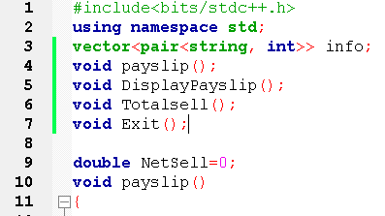
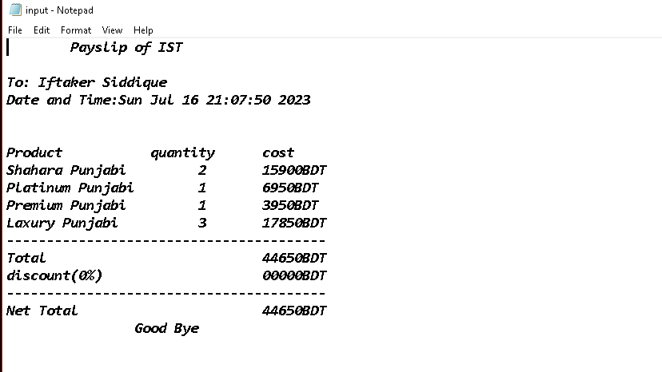
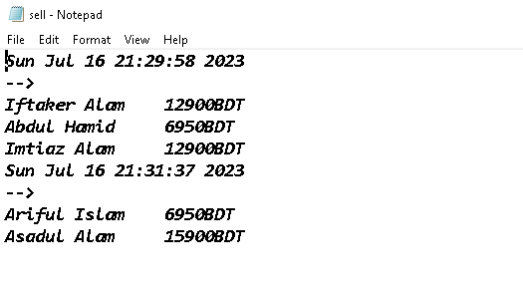
Methodology
C++ Language
Data Structure
Function
File Handling

Slide 6
Demonstration
Home Screen
Create Pay-slip
Display Pay-slip
Display Total Sell
Store Sell details

Slide 7
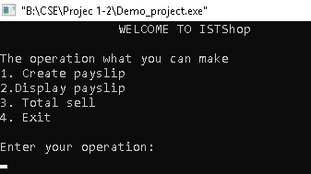
Home Screen

Slide 8
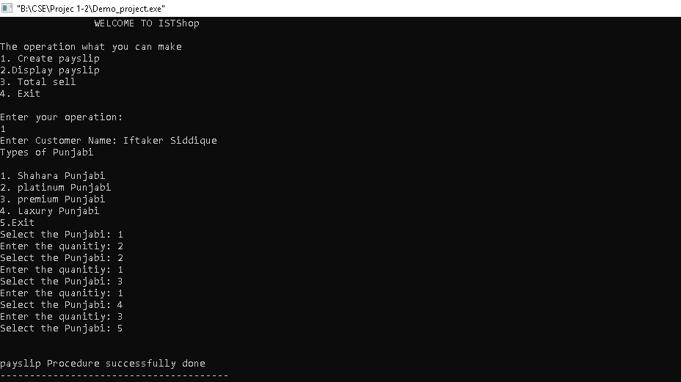
Create Pay-slip
For Creating Slip
Customer Name
Types of Punjabi
Quantity of Punjabi

Slide 9
Display Pay-Slip
Taking the Info about Customer From Create Pay-Slip
Convert in a file as Pay-Slip
Demo of File

Slide 10
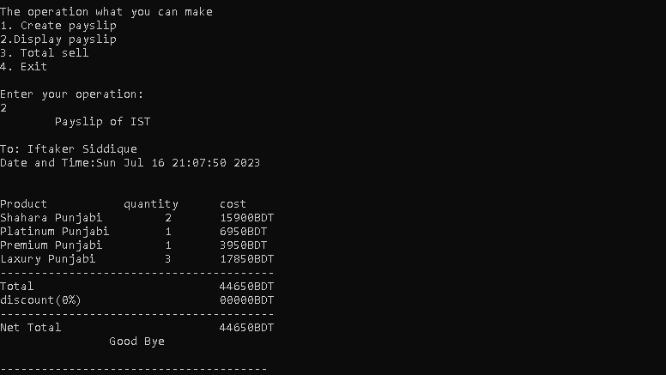
Terminal Read the File and Display the Pay-Slip

Slide 11
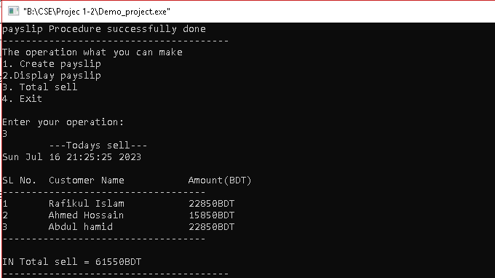
Display Total Sell
It Shows us the Total sell of a whole day by storing Customer Name and Purchase details
A demo of Showing a day selling details

Slide 12
Storing Sell Details
Sell details will Store in a file for future sell inventory With sell date and time
A demo of storing sell details Date and Time wise
Date & Time
Total sell of specific Day

Slide 13
Benefits
For Customer
For Business
Legal information about purchase
Changing product
Better Understanding about product
Legal information about sells
Automation of billing System
Better Customer Service
Inventory Management

Slide 14
Conclusion
Legal Purchase for customer
Sell inventory management
Less time consume for billing system
Sell detail for future observation about sells in business
Better customer Service in business
Legal way of changing product for customer

Slide 15
Thank You
For your kind attention

